Slide 1


Department of BES1
Data structures
24SC1203
Topic:
STACK APPLICATIONS
Session – 15

Slide 2



AIM OF THE SESSION
To familiarize students with the Applications of stacks.
INSTRUCTIONAL OBJECTIVES
This Session is designed to bring:
A deep knowledge on how stack implementation plays its role in day to day computations .
How to Apply stack operations for easy handling of majority Memory Operations in this computerized era.
Describe Applications of stacks.
Knowledge on expression conversions and evaluations.
LEARNING OUTCOMES
At the end of this session, you should be able to:
Know where stack takes its place in computations.
Describe how to convert an Infix to postfix notation.

Slide 3
SESSION INTRODUCTION
Problems that Use Stacks :
Evaluation of Arithmetic expressions.
Processing Function calls.
Reverse a Data.
Undo, Redo operations.
Delimiter Checking.

Slide 4
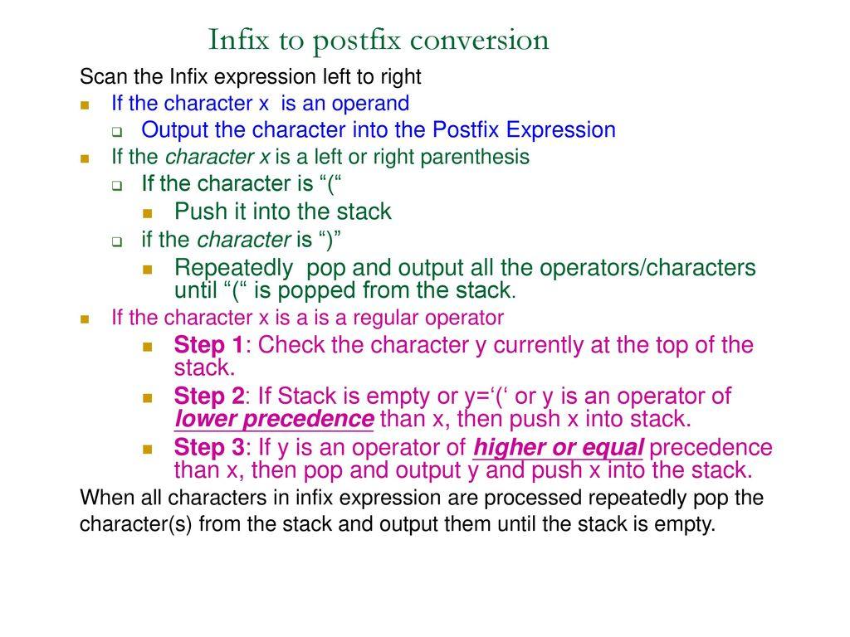
Algorithm :Infix to Postfix conversion

Slide 5
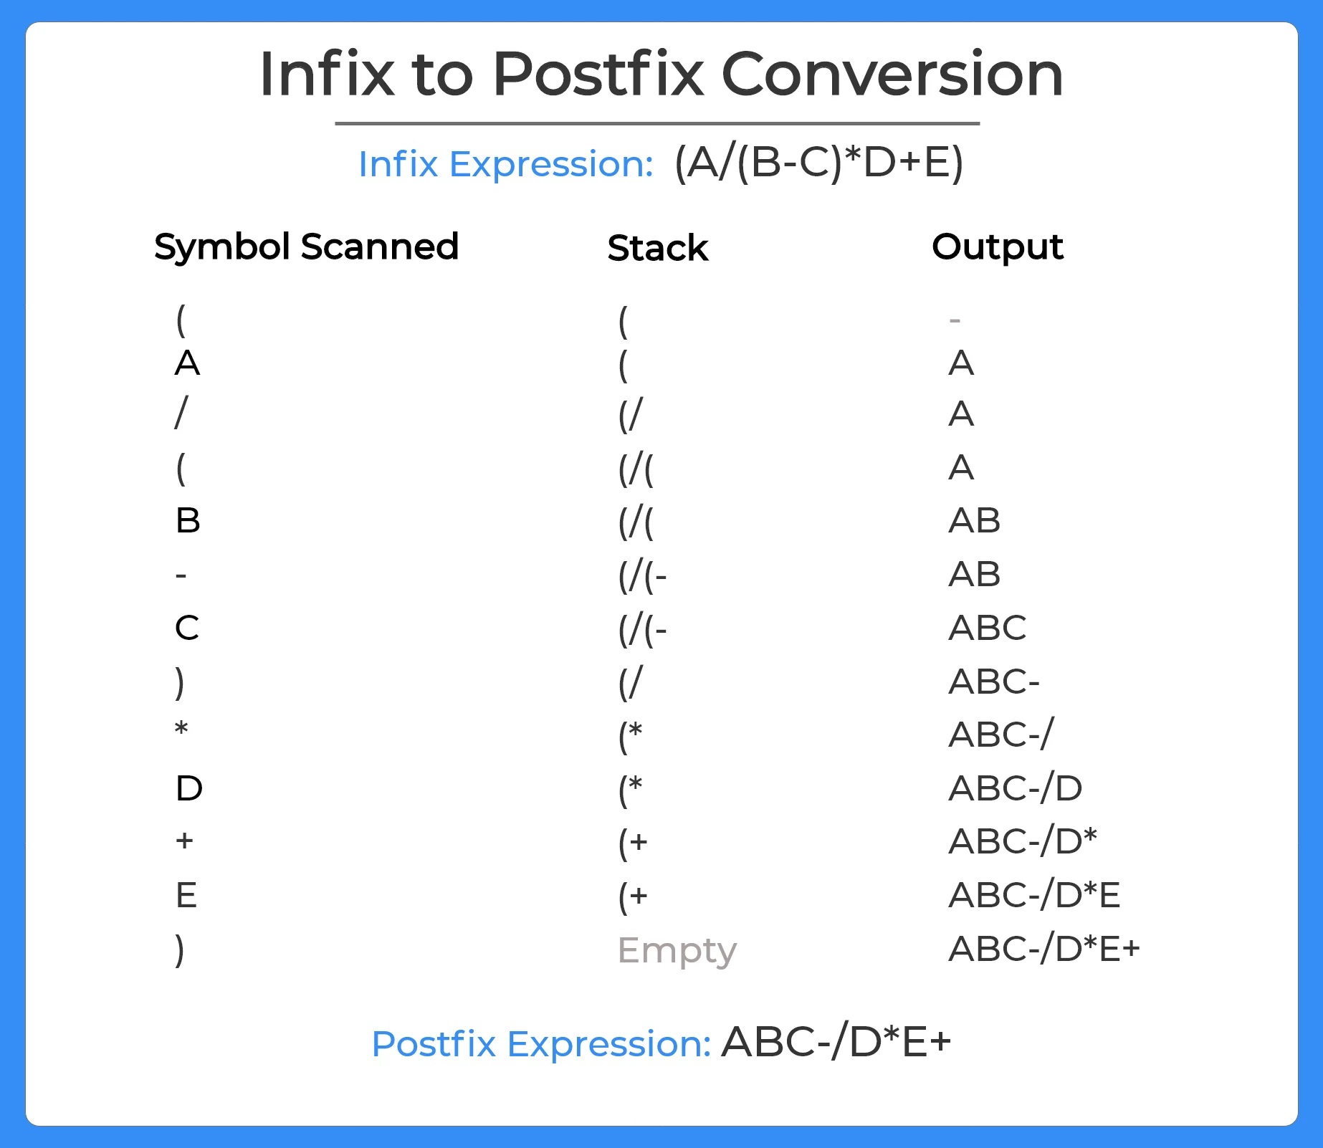
Infix to Postfix Conversion Cont…

Slide 6
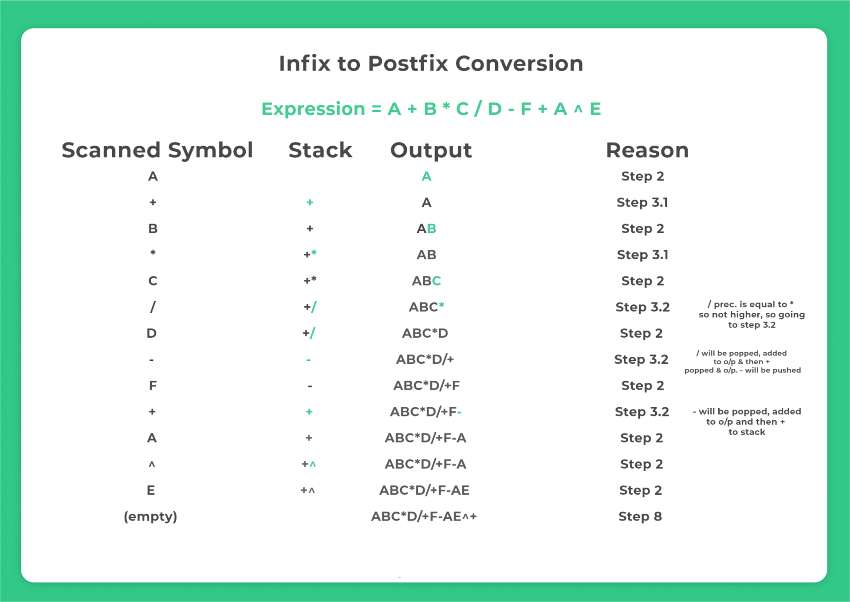

Slide 7

Infix to postfix conversion
infixVect
( a + b - c ) * d – ( e + f )
postfixVect

Slide 8
Infix to postfix conversion
stackVect
.
infixVect
a + b - c ) * d – ( e + f )
postfixVect
(

Slide 9
Infix to postfix conversion
stackVect
infixVect
+ b - c ) * d – ( e + f )
postfixVect
a
(

Slide 10
Infix to postfix conversion
stackVect
infixVect
b - c ) * d – ( e + f )
postfixVect
a
+
(

Slide 11
Infix to postfix conversion
stackVect
infixVect
- c ) * d – ( e + f )
postfixVect
a b
+
(

Slide 12
Infix to postfix conversion
stackVect
infixVect
c ) * d – ( e + f )
postfixVect
a b +
-
(

Slide 13
Infix to postfix conversion
stackVect
infixVect
) * d – ( e + f )
postfixVect
a b + c
-
(

Slide 14
Infix to postfix conversion
stackVect
infixVect
* d – ( e + f )
postfixVect
a b + c -

Slide 15
Infix to postfix conversion
stackVect
infixVect
d – ( e + f )
postfixVect
a b + c -
*

Slide 16
Infix to postfix conversion
stackVect
infixVect
– ( e + f )
postfixVect
a b + c - d
*

Slide 17
Infix to postfix conversion
stackVect
infixVect
( e + f )
postfixVect
a b + c – d *
-

Slide 18
Infix to postfix conversion
stackVect
infixVect
e + f )
postfixVect
a b + c – d *
(
-

Slide 19
Infix to postfix conversion
stackVect
infixVect
+ f )
postfixVect
a b + c – d * e
(
-
-

Slide 20
Infix to postfix conversion
stackVect
infixVect
f )
postfixVect
a b + c – d * e
+
(
-

Slide 21
Infix to postfix conversion
stackVect
infixVect
)
postfixVect
a b + c – d * e f
+
(
-

Slide 22
Infix to postfix conversion
stackVector
infixVect
postfixVect
a b + c – d * e f +
-

Slide 23
Infix to postfix conversion
stackVect
infixVect
postfixVect
a b + c – d * e f + -

Slide 24
What is
SELF-ASSESSMENT QUESTIONS
Which of the following statement is incorrect with respect to infix to postfix conversion algorithm?
a) operand is always placed in the output
b) operator is placed in the stack when the stack operator has lower precedence
c) parenthesis are included in the output
d) higher and equal priority operators follow the same condition
Out of the following operators (|, *, +, &, $), the one having lowest priority is ________
a) +
b) $
c) |
d) &

Slide 25
TERMINAL QUESTIONS
1. Describe expression Notations
2. List out Stack Applications
3. Analyze and Evaluate Postfix and infix notations
4. Summarize stack in memory operations

Slide 26
REFERENCES FOR FURTHER LEARNING OF THE SESSION
Reference Books:
1. A.v.Aho,J.E.Hopcroft,and J.D.Ullman ,”Data structures And Algorithms”,Pearson Education 1e.
2. “Fundamentals of Data Structures in C”,Horowitz,Sahni,Anderson Freed 2e-2007
3.R.F.Gilberg,B.A.Forouzan,”Data Structures” 2e Thomson India Edition-2007
Sites and Web links:
1. https://nptel.ac.in/courses/106102064
2. https://www.edx.org/course/algorithms -and -data-structures-1
3. https://www.coursera.org/learn/data-structures?action=enroll

Slide 27
THANK YOU
Team – DATA STRUCTURES

